Slide 1
Review- Aug 4

Slide 2
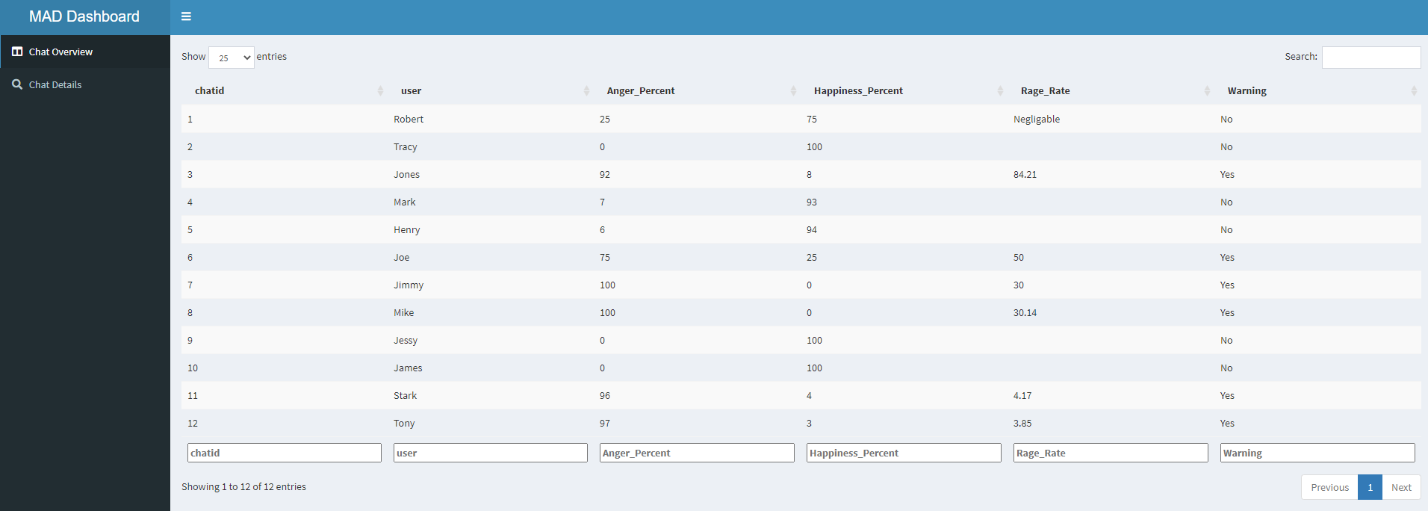

Slide 3
CHAT OVERVIEW SCREEN

Slide 4
chatid | chatorder | Anger (1-5) | Happy (1-5)
1 | 1 | 5 | 0
1 | 2 | 0 | 5
1 | 3 | 0 | 5
1 | 4 | 0 | 5
1 |  | 5 | 15

Slide 5
CHAT ID 1
543210
Since in a rate plot,
At least require 2 data points
i.e., Model should have scored
Anger scores on chat at least
Two times
ANGER
SCORE
1 2 3 4 5…….
CHAT ORDER

Slide 6
Anger_Percent>50
OR
Rage_Rate>3.9
OR
Rage_Rate>3.9 & Anger_Percent>50

Slide 7
CHAT DETAIL SCREEN

Slide 8
